Slide 1
Dasar-Dasar Pemograman Java
@Indonesia Reinsurance

Slide 2
Java?

Slide 3
JVM

Slide 4
Java Compiler

Slide 5
Java Documentation

Slide 6
Java Tools
IDE
Build Tools

Slide 7
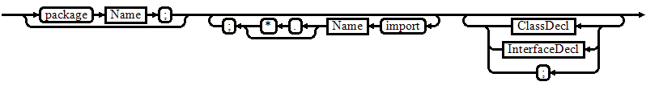

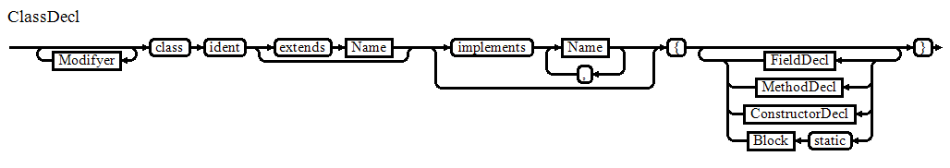
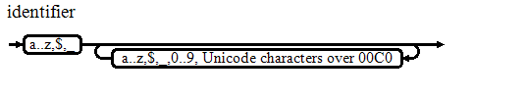
Java Compilation Unit

Slide 8
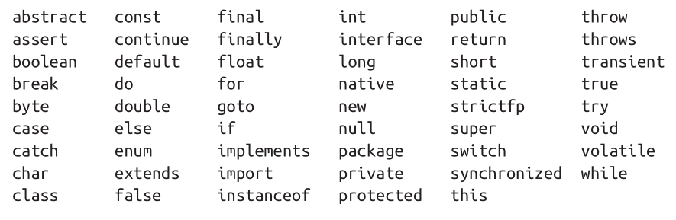
Java Keywords

Slide 9

Simple Java Program

Slide 10
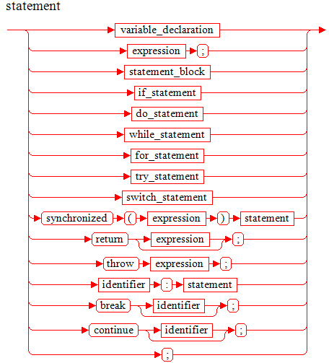
Statement

Slide 11

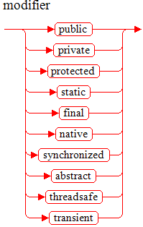

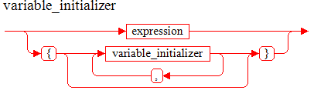
Deklarasi Variabel

Slide 12
Identifier
Identifier:
IdentifierChars but not a Keyword or BooleanLiteral or NullLiteral
IdentifierChars:
JavaLetter {JavaLetterOrDigit}
JavaLetter:
any Unicode character that is a "Java letter"
JavaLetterOrDigit:
any Unicode character that is a "Java letter-or-digit"
BooleanLiteral:
(one of) true false
NullLiteral:
null

Slide 13
Literal
IntegerLiteral
FloatingPointLiteral
BooleanLiteral
CharacterLiteral
StringLiteral
NullLiteral

Slide 14
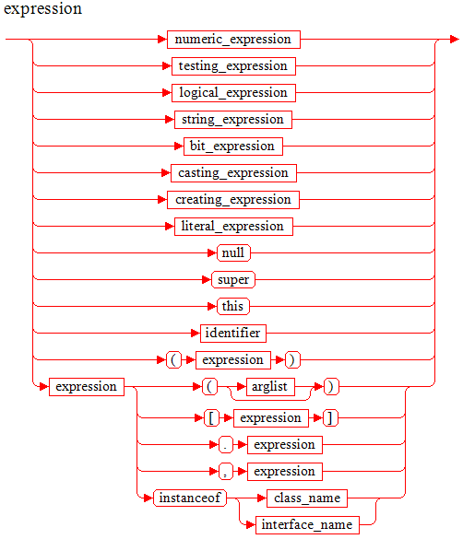
Ekpresi

Slide 15
Type?
Variable
Argument
Return Type
Operation

Slide 16
Primitive Type
Nama Type bagian dari keyword/reserved word
Pass by value
operasi terdefinisi di java dan final.

Slide 17
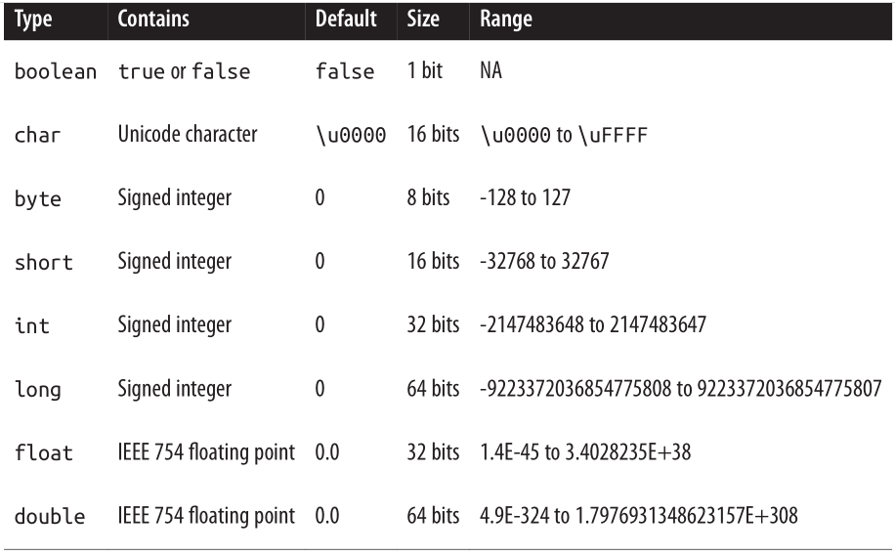
Primitive Type (kapasitas)

Slide 18
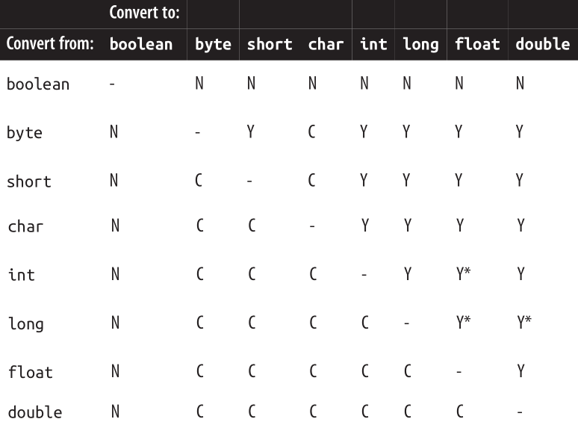
Primitive Type (konversi)
N = Tidak bisa di konversi, C = Bisa Dikonvesi Sempurna
Y = Bisa Dikonversi dgn Peluasan, * terjadi penyesuaian presisi nilai

Slide 19
Primitive Type (casting)
Down Casting
Up Casting
int i = 10;
byte b = (byte) i;
Java tidak melakukan down casting secara otomatis (implisit) karena ada kemungkinan terjadi kerusakan data/presisi.
byte b = 10;
int i = (byte) b;
Java bisa melakukan up casting secara otomatis (implisit).

Slide 20
Primitive Type (wrapper)
Setiap primitive type memiliki padanan Reference Type yg berperan memberikan fitur2 tambahan.
boolean ➔ Boolean
byte ➔ Byte
short ➔ Short
char ➔ Character
int ➔ Integer
long ➔ Long
float ➔ Float
double ➔ Double
Boxing = perubahan dari primitive ke reference type
Unboxing = perubahan dari reference type ke primitive

Slide 21
Reference Type
Nama Type sesuai aturan identifier java
Pass By Reference
Operasi di definisikan.

Slide 22
Operator
Category | Operator | Associativity
Postfix | () [] . (dot operator) | Kiri ke Kanan
Unary | ++ - - ! ~ | Kanan ke Kiri
Multiplicative | * / | Kiri ke Kanan
Additive | + - | Kiri ke Kanan
Shift | >> >>> << | Kiri ke Kanan
Relational | > >= < < = | Kiri ke Kanan
Equality | == != | Kiri ke Kanan
Bitwise AND | & | Kiri ke Kanan
Bitwise XOR | ^ | Kiri ke Kanan
Bitwise OR | | | Kiri ke Kanan
Logical AND | && | Kiri ke Kanan
Logical OR | || | Kiri ke Kanan
Conditional | ?: | Kanan ke Kiri
Assignment | = += -= *= /= %= >>= >>>= <<= &= ^= |= | Kanan ke Kiri

Slide 23
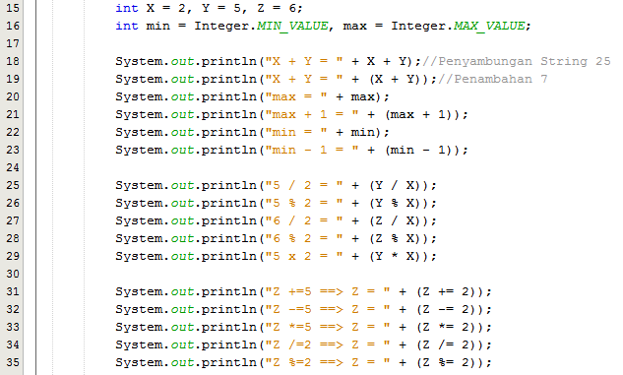
Operator (Arithmetic-Integer Operation)

Slide 24
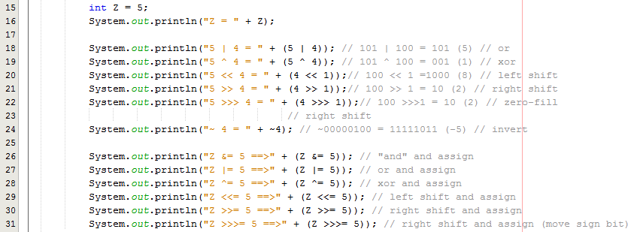
Operator (Bitwise)

Slide 25
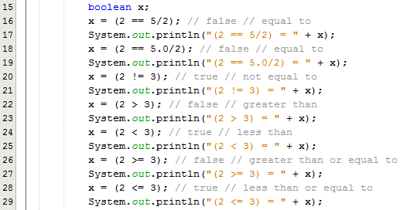
Operator (Perbandingan)

Slide 26

Operator (Logika)

Slide 27
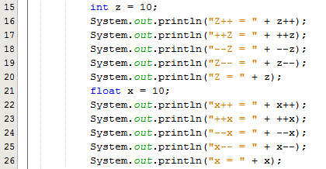
Operator (Inc/Dec)

Slide 28
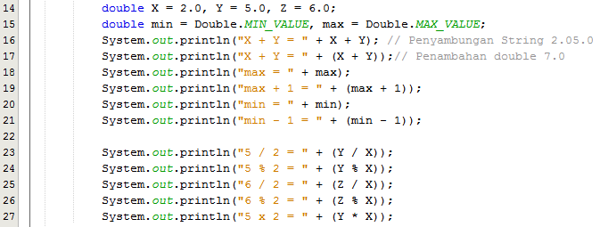
Operator (Floating Point)

Slide 29

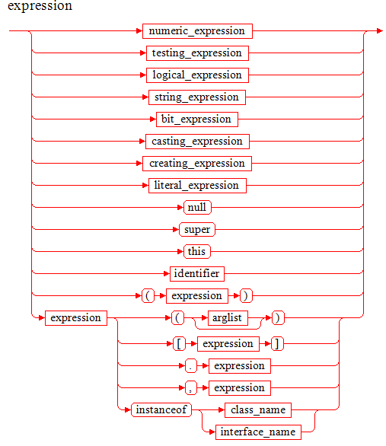
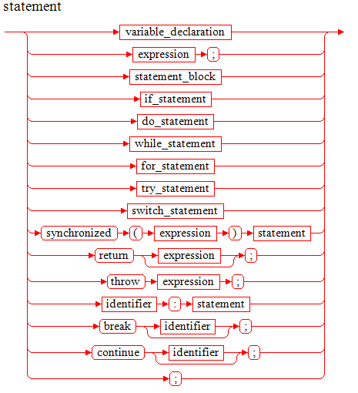
Control Flow (If-Else)
The Expression must have type boolean or Boolean, or a compile-time error occurs.

Slide 30
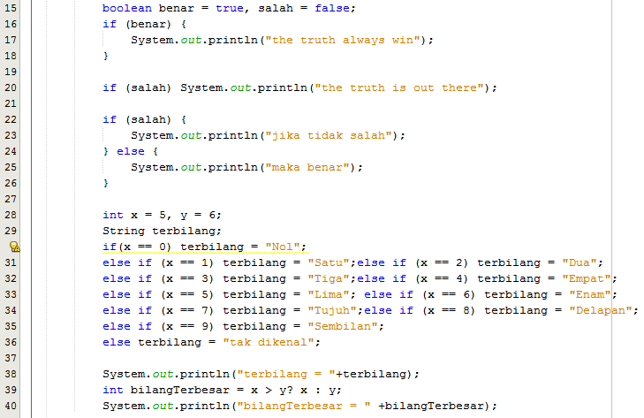
Control Flow (…If-Else)

Slide 31
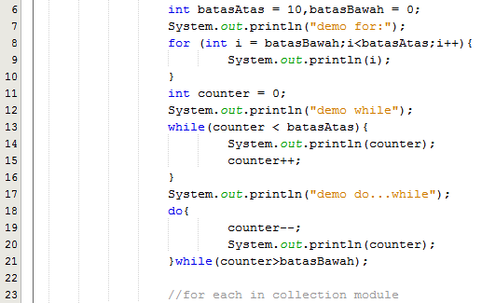
Control Flow (Perulangan)

Slide 32
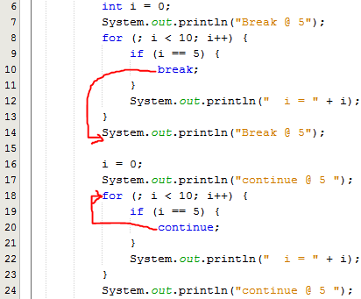
Control Flow (Label Block)

Slide 33
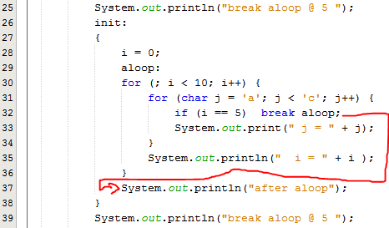
Control Flow (…Label Block)

Slide 34
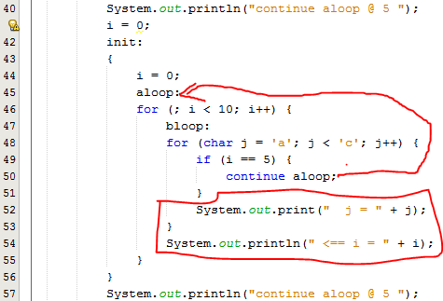
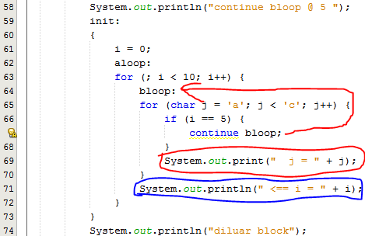
Control Flow (…Label Block)

Slide 35
Control Flow (Exception Handling)
Java punya 2 jenis kesalahan (Throwable )
Error, kesalahan fatal pada sistem, aplikasi tidak disarankan menanggulangi ini.
Exception, disarankan untuk ditanggulangi oleh aplikasi.
Java membagi 2 jenis Exception
Run Time Exception (java.lang.RuntimeException)
Compile Time/Checked Excepition( non - java.lang.RuntimeException)
Jangan gunakan exception untuk kesalahan logika bisnis/aplikasi.
Notes:
Unchecked exceptions: represent defects in the program (bugs) - often invalid arguments passed to a non-private method. To quote from The Java Programming Language, by Gosling, Arnold, and Holmes: "Unchecked runtime exceptions represent conditions that, generally speaking, reflect errors in your program's logic and cannot be reasonably recovered from at run time."
are subclasses of RuntimeException, and are usually implemented using IllegalArgumentException, NullPointerException, or IllegalStateException
a method is not obliged to establish a policy for the unchecked exceptions thrown by its implementation (and they almost always do not do so)
Checked exceptions: represent invalid conditions in areas outside the immediate control of the program (invalid user input, database problems, network outages, absent files)
are subclasses of Exception
a method is obliged to establish a policy for all checked exceptions thrown by its implementation (either pass the checked exception further up the stack, or handle it somehow)

Slide 36

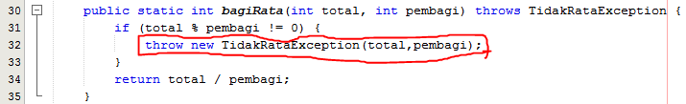
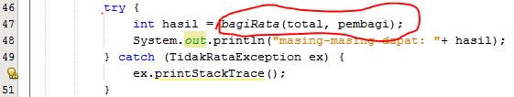
Control Flow (Checked Exception)

Slide 37
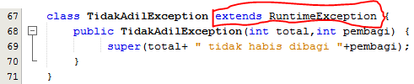
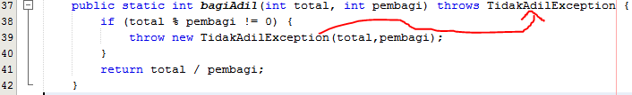

Control Flow (Runtime Exception)

Slide 38
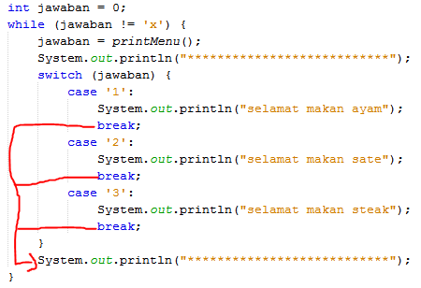
Control Flow (switch-case)

Slide 39
Reference Type
Java merupakan bahasa pemograman yang mendukung paradigma Object-Oriented Programming yang berbasis kelas.
Kelas (class) di java sering juga disebut reference type, atau singkatnya type.
Kelas merupakan “cetak-biru” untuk sebuah object.
Selain Kelas java juga mengenal interface, variable dan array.
Java memiliki beberapa Kelas yang istimewa seperti Object, Array, Enum dkk.

Slide 40

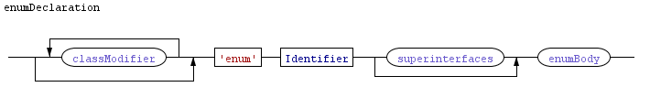
Deklarasi Kelas

Slide 41

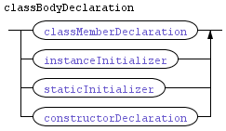
…Deklarasi Kelas

Slide 42


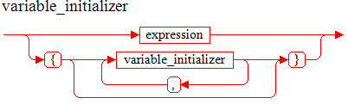
Deklarasi Variabel Kelas

Slide 43



Deklarasi Metode Kelas

Slide 44
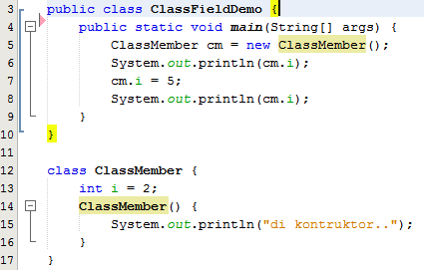
Sample Field Declaration

Slide 45
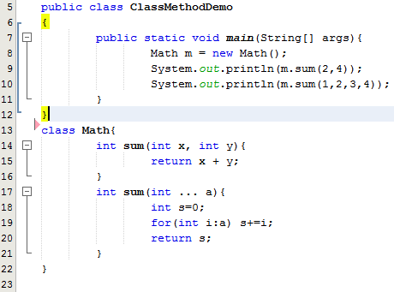
Sample Method Declaration

Slide 46
Method Overloading
Beberapa metode memiliki nama sama, dan bedakan berdasarkan parameternya.

Slide 47
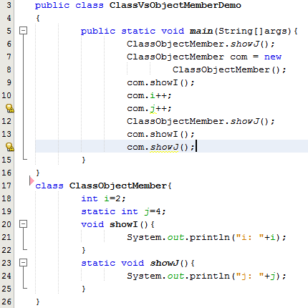
Static

